Slide 1
Attendance management system with integrated telegram bot
- E002,E006,E010

Slide 2
Motivation and the idea

Slide 3
Problem Statement:
The current procedure followed to alert the student of the their attendance checks the attendance at the end of a specified period of time and the cumulative percentages are mailed to the respective students.
If the student is in the defaulter’s list then they are alerted separately.
A student cannot check the attendance at any given point in time as the sheets are not made available to them.
If a student misses a few days then they will have to go each teacher individually to realize the dent in attendance, missing that few day got them and how to plan the lectures hence forth.
There’s no common terminal where the attended hours for each subject can be seen at any given point in time.

Slide 4
Solution:
The given program aims to curb the issues caused by the problem statement by making the attendance retrieval automated.
Every subject has it’s own spreadsheet that maintains the attended hours and attended percentage for that student and is updated after every lecture hence containing the latest percentage.
The program fetches the required data from the selected spreadsheet and displays it to the user.
To make the retrieval convenient at the user end, 2 types of terminals are provided to the user to check their attendance.
Student can check their attendance at either the GUI end made using Tkinter OR by communicating with the AttendanceSeekerBot.

Slide 5
Technical Overview:
The student connects to the Telegram bot named : ----. The bot starts up on the command ‘/start’. Then the student can send the bot their information in the specified format.
The bot sends the data to the code which hosts the bot and the formatting of the data is validated by the code.
This data is then checked and the appropriate spreadsheet is selected with the appropriate sheet number judging by the subject name.
The name of the student is linearly searched in the spreadsheet and if found, the corresponding row is retrieved.
The GUI similarly takes the data from the user and it is used to find the row in the spreadsheet.

Slide 6
Coding logic

Slide 7
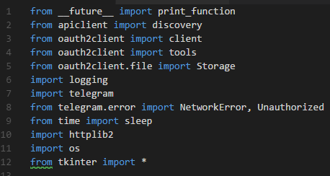
import Statements used

Slide 8
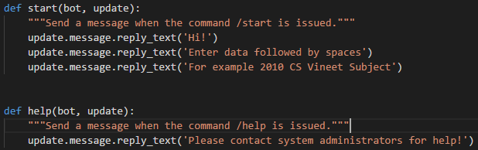
Hosting the Telegram Bot
Calling the bot using the Authorization Token
Defining functions for primary fixed replies

Slide 9
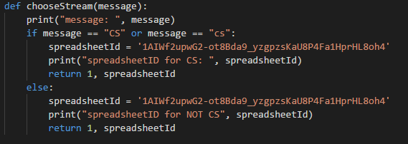
Choosing the spreadsheet:
Calls the respective spreadsheet depending upon the stream given by the user.
Every spreadsheet has it’s own google spreadsheet ID.

Slide 10
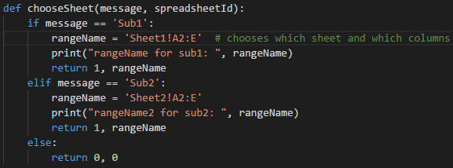
Choosing the sheet:
A google spreadsheet can have multiple sheets that are analogous to how the attendance for different subjects for a class is stored.
It selects the necessary columns from the sheet according to the subject selected in the specified stream.

Slide 11
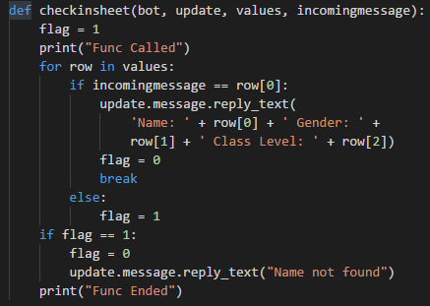
Finding the required name
The values in the sheet are acquired and this function parses through them to find the value and generate a reply message.

Slide 12
Results

Slide 13
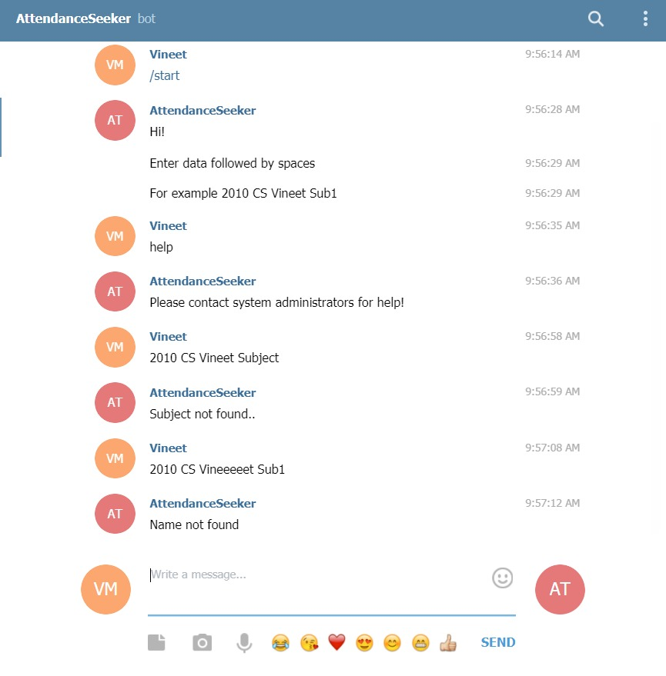
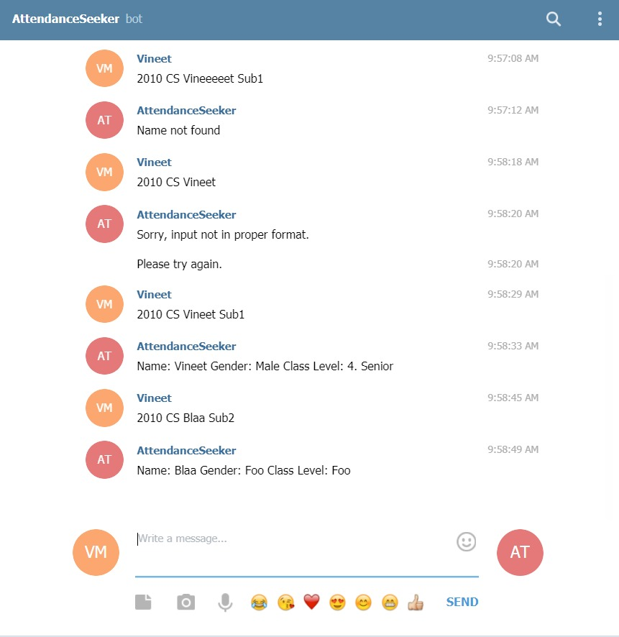
Interaction With Telegram Bot

Slide 14
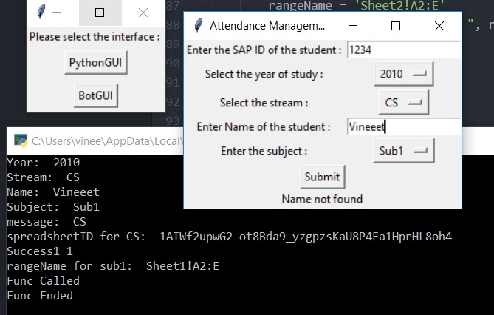
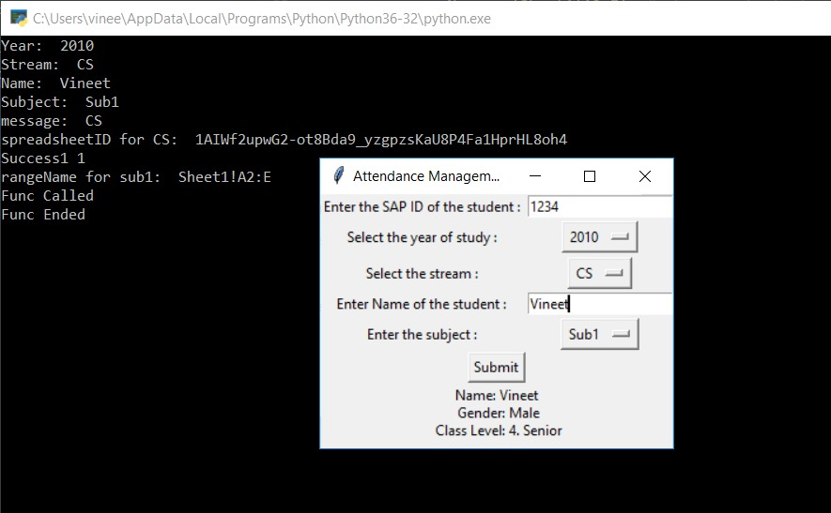
GUI(Tkinter) End

Slide 15
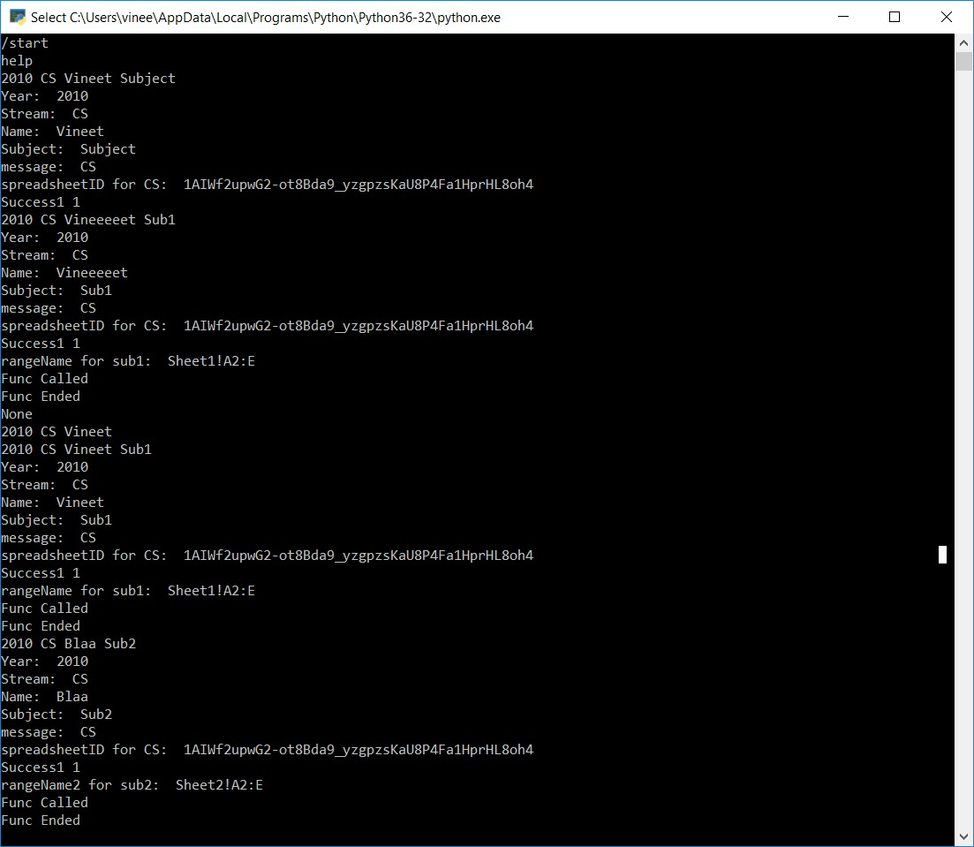
Terminal at the Host

Slide 16
Thank You

